Slide 1

TITANIC PLATFORM

Slide 2

TEAM MEMBERS

Slide 3
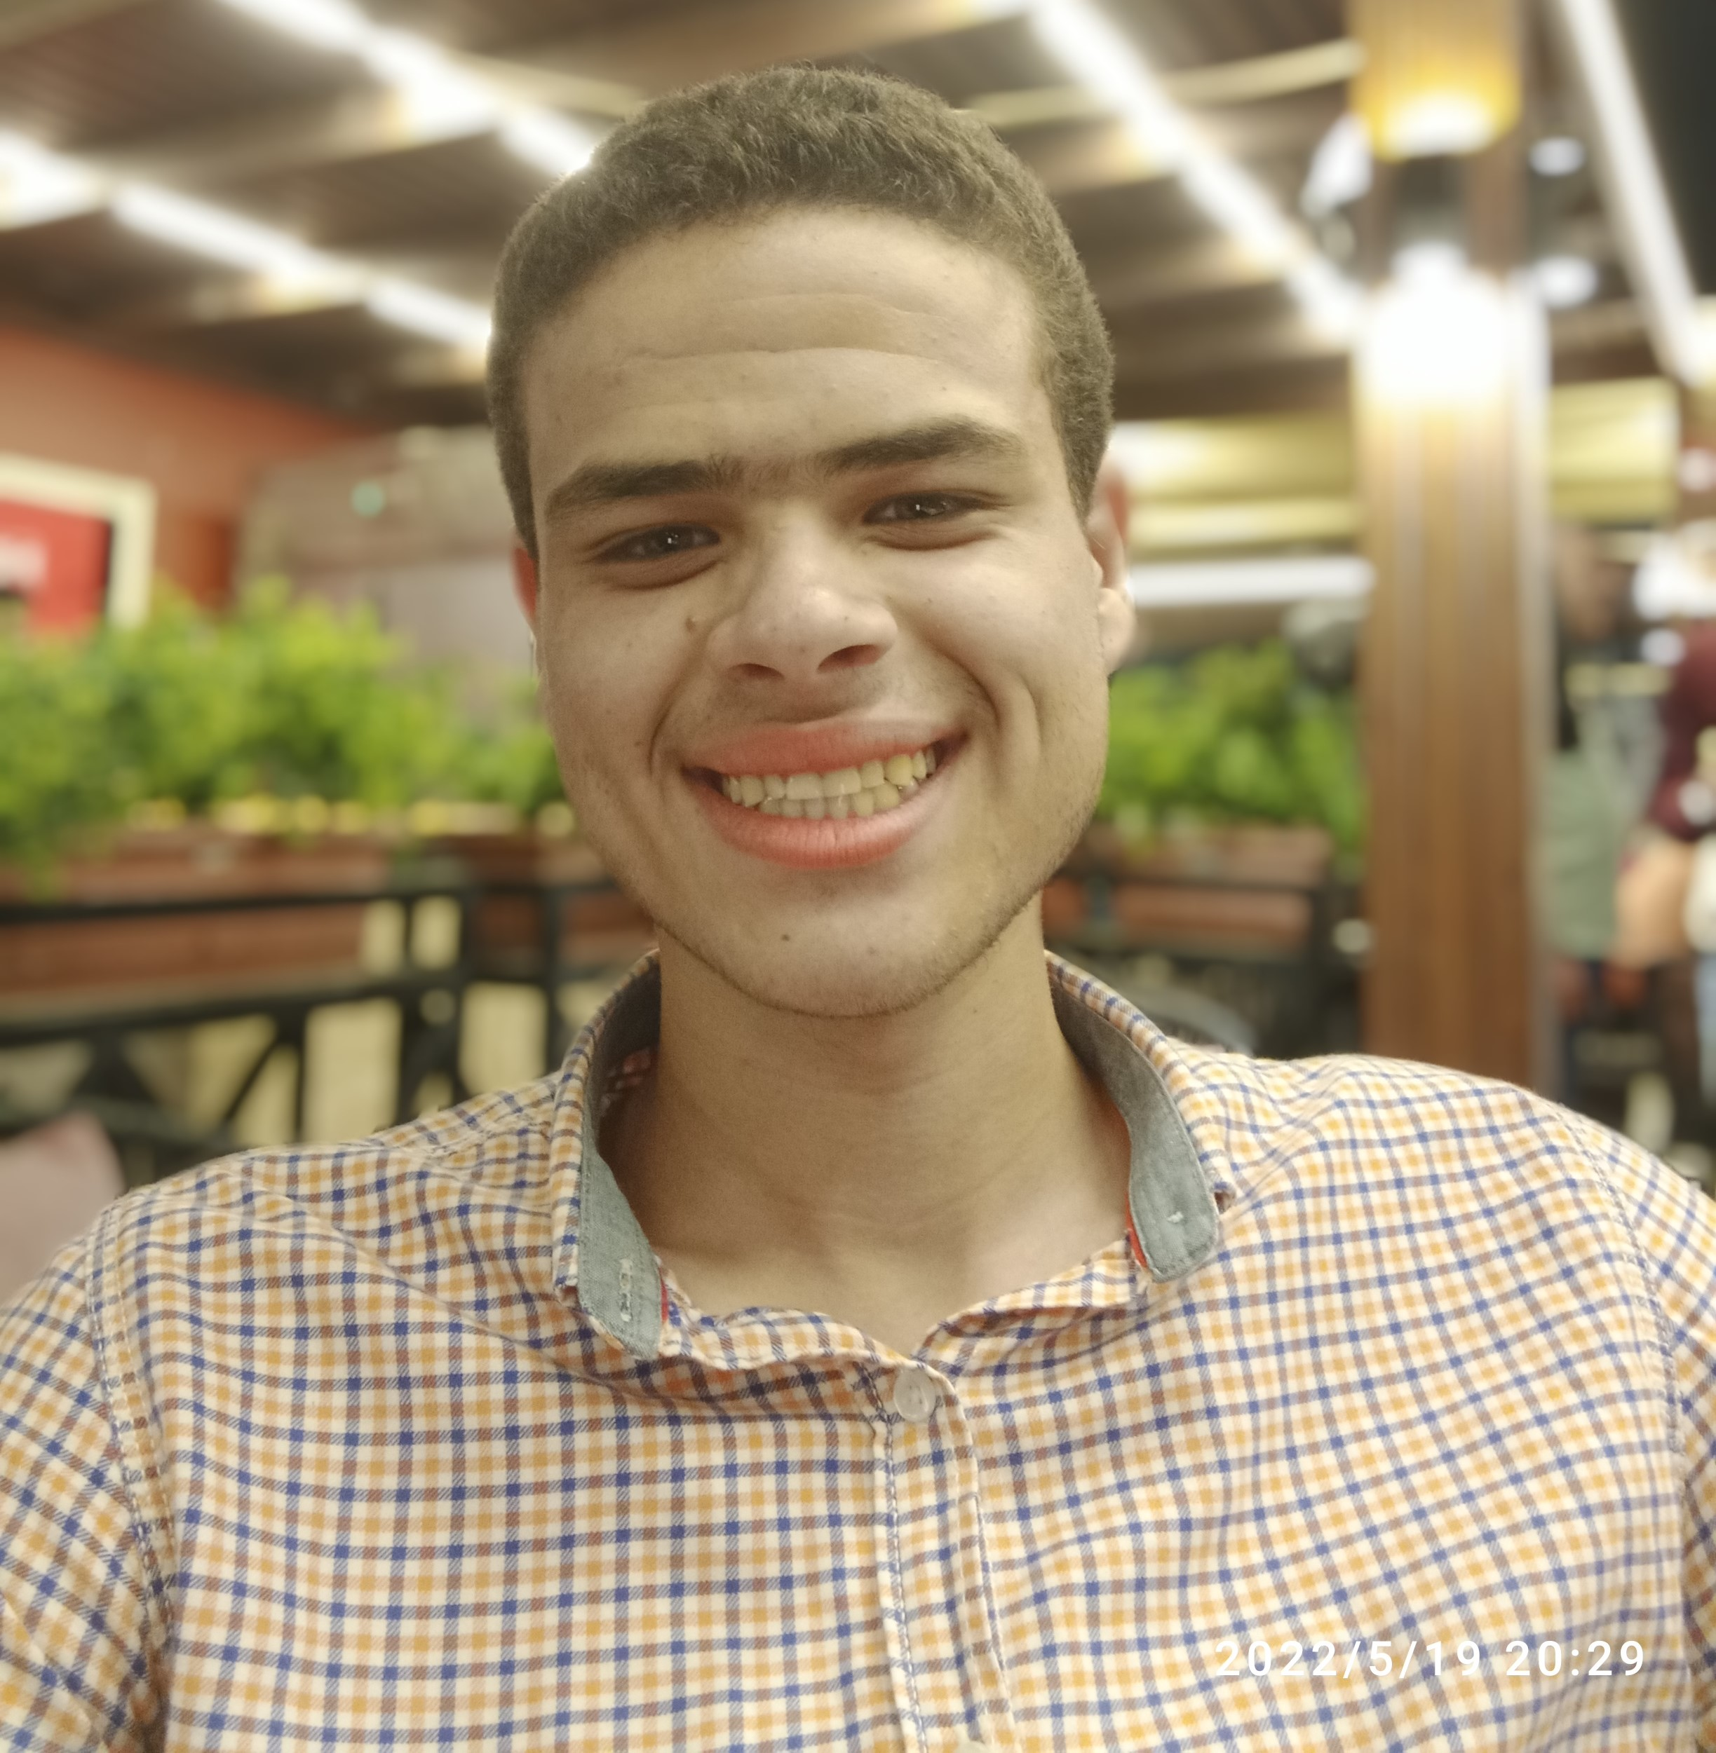
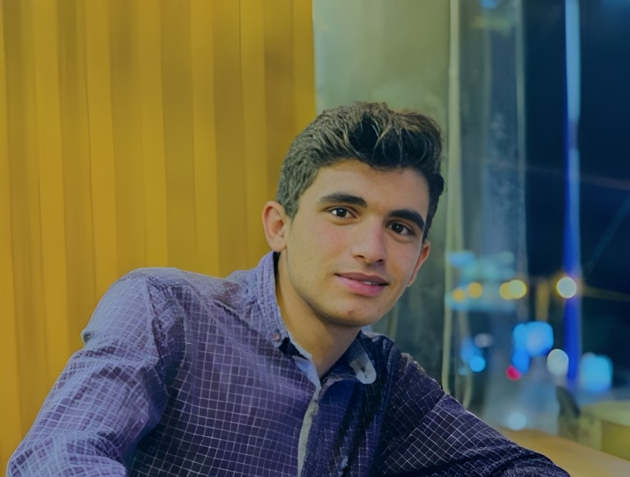
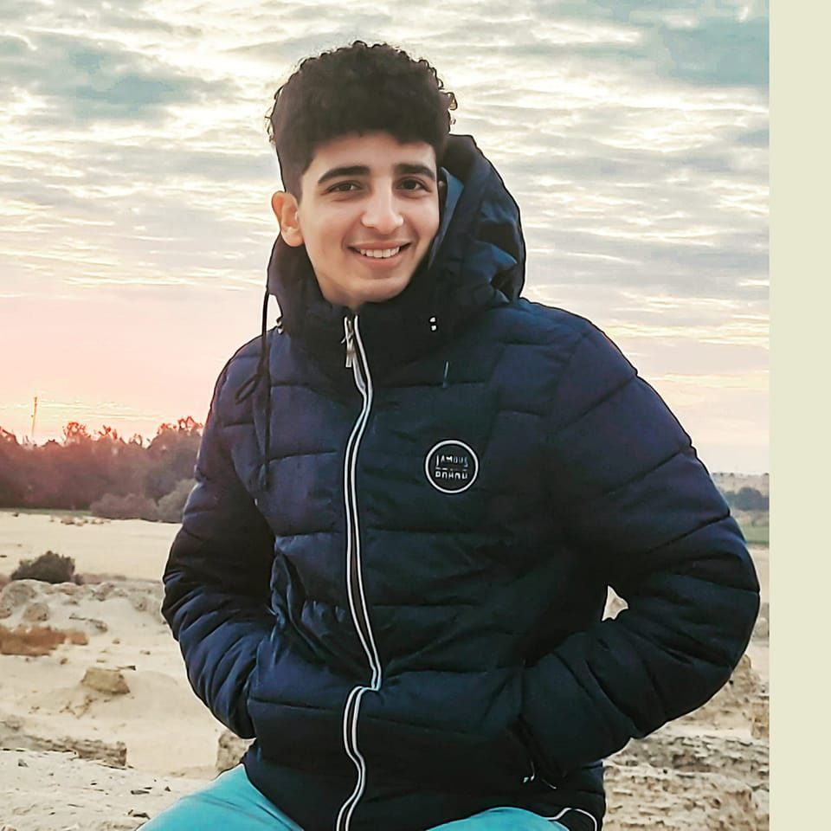
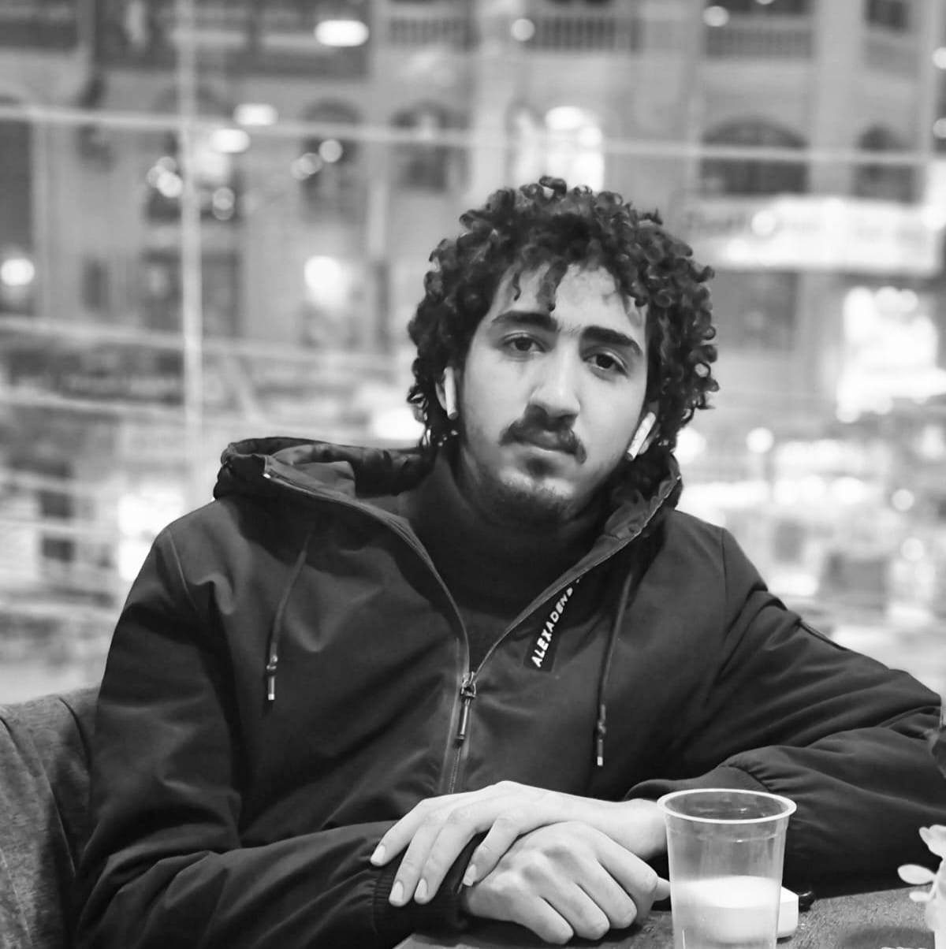
Ali Mohamed
Machine learning Engineer
Leader
Beltagy Mohamed
Data Analyst
Mohamed Ahmed
Frontend Developer
Ziad Selim
Backend Developer
Abdelrahman Ramadan Backend Developer

Slide 4
INTRODCUTION
Brief overview of the Titanic Website System.
Purpose and objectives of the system.
Target audience and stakeholders.

Slide 5
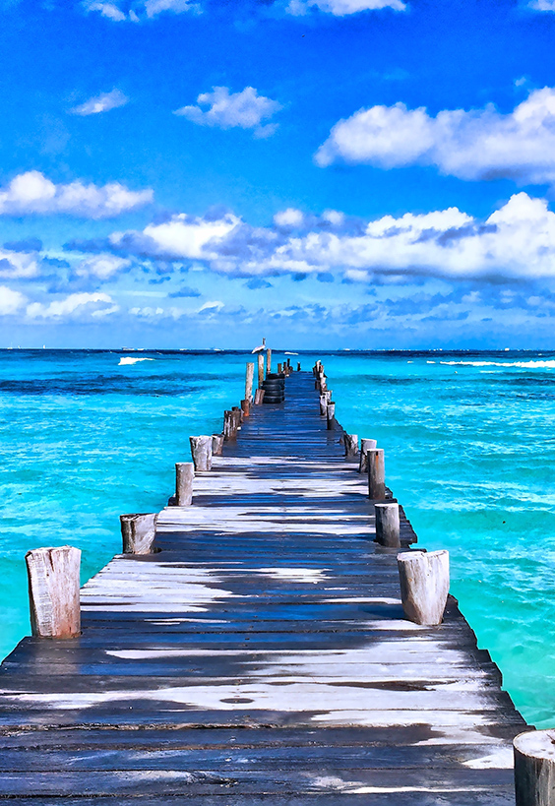
OVERVIEW
The Titanic Website System is a web application designed to provide users with an interactive and informative experience related to the historic RMS Titanic. It incorporates a machine learning model to predict the likelihood of survival for an individual based on various input parameters such as passenger class, gender, age, and more. The system not only offers predictive capabilities but also serves as an engaging platform for users interested in learning about the Titanic's history.

Slide 6

PURPOSE
The primary purpose of the Titanic Website System is to merge historical data with modern technology, offering users an immersive experience. It aims to:
Provide users with a personalized prediction of survival on the Titanic based on their input data.
Disseminate information about the Titanic's history, passengers, and the disaster itself.
Create an engaging and user-friendly platform for individuals interested in exploring and learning about the Titanic.

Slide 7
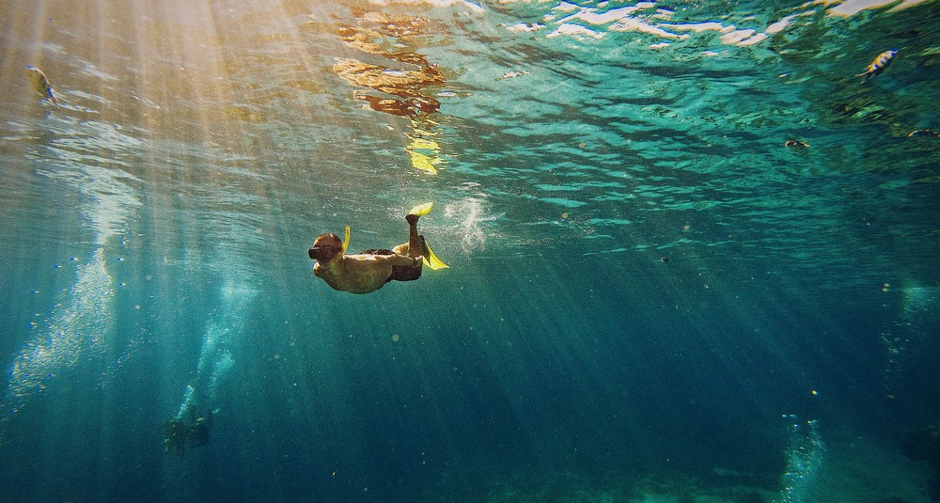
OBJECTIVES
The specific objectives of the Titanic Website System include:
Implement a machine learning model trained on the Titanic dataset to predict survival probabilities.
Develop a user-friendly interface that allows users to input their details for predictions.
Offer clear and concise information about the Titanic, its passengers, and historical context.
Provide easy navigation to different sections, including prediction, about, and contact.

Slide 8

TARGET AUDIENCE
The Titanic Website System caters to a diverse audience with interests ranging from history and maritime enthusiasts to individuals curious about their survival likelihood on the Titanic. The primary target audience includes:
History enthusiasts and researchers interested in the Titanic.
Students studying historical events or machine learning applications.
General users seeking an engaging and interactive web experience.

Slide 9
STAKEHOLDERS
USERS
DATA SCIENTISTS
DEVELOPERS
Individuals interacting with the website for predictions, information, or exploration.
Experts involved in developing and maintaining the machine learning model.
The team responsible for building, maintaining, and updating the website.

Slide 10
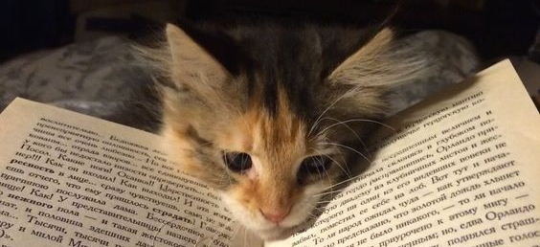
USER-STORY

Slide 11
User Story 1: Predicting Survival
As a user, I want to input my details (Pclass, Gender, Age, SibSp, Parch, Fare, Embarked) to the Titanic website to receive a prediction on whether I would have survived the Titanic disaster or not.
Acceptance Criteria:
The website should provide a clear and user-friendly form for input.
The prediction result should be displayed in an easily understandable format

Slide 12
User Story 2: Website Navigation
As a user, I want the website to have easy navigation to access different sections like "About," "Contact," and "Prediction Result.
Acceptance Criteria:
Clear navigation links.
Responsive design for various devices.

Slide 13
User Story 3: Survival Analytics Dashboard
As a website user, I want to explore insightful analytics related to the survival outcomes of Titanic passengers through an intuitive dashboard. This will enable me to gain a deeper understanding of various factors influencing survival rates.
Acceptance Criteria:
Filtering Options.
Interactive Elements.
Responsive Design.
Performance

Slide 14
User Story 4: About the Titanic
As a user curious about the historical context of the Titanic, I want to access a comprehensive "About" section on the website. This section should provide detailed information about the Titanic, its history, construction, maiden voyage, and the events leading to its tragic sinking.
Acceptance Criteria:
Accessible Navigation:
Interactive Elements.
Engaging Content:.
Multimedia Elements
Passenger Stories
Citations and References
Responsive Design

Slide 15
User Story 5: Contact Titanic Website
As a user of the Titanic website, I want the ability to contact the support team for inquiries, assistance, or to report issues. This will provide a direct communication channel, ensuring a seamless and responsive experience for users.
Acceptance Criteria:
Accessible Contact Section.
User-Friendly Contact Form

Slide 16
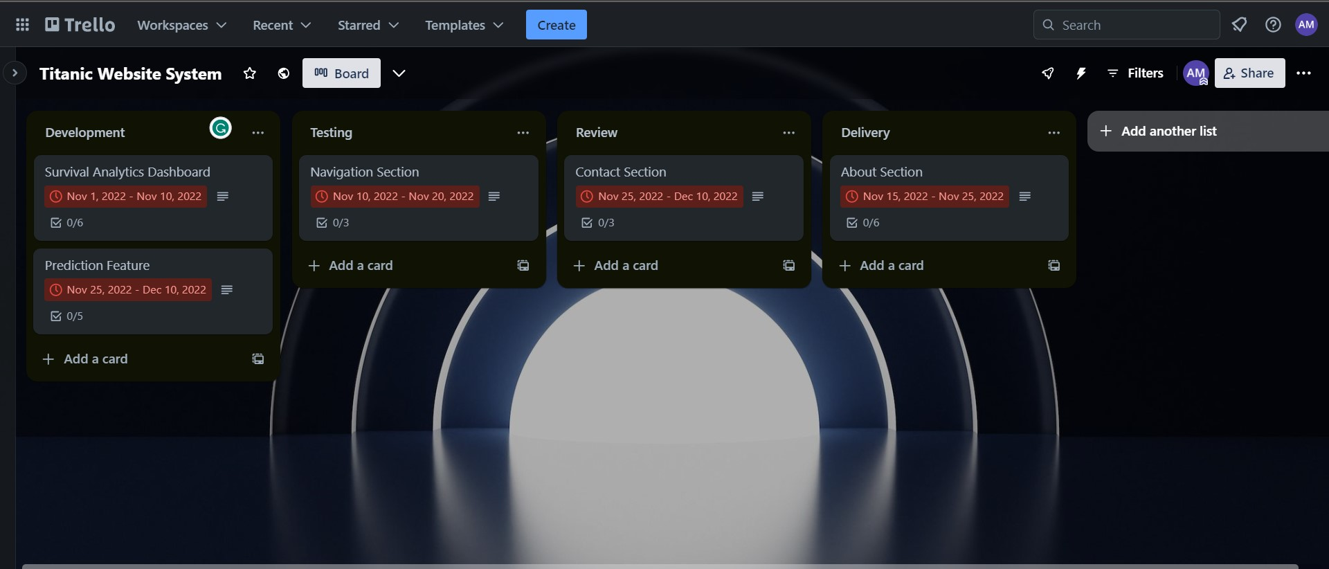

Slide 17
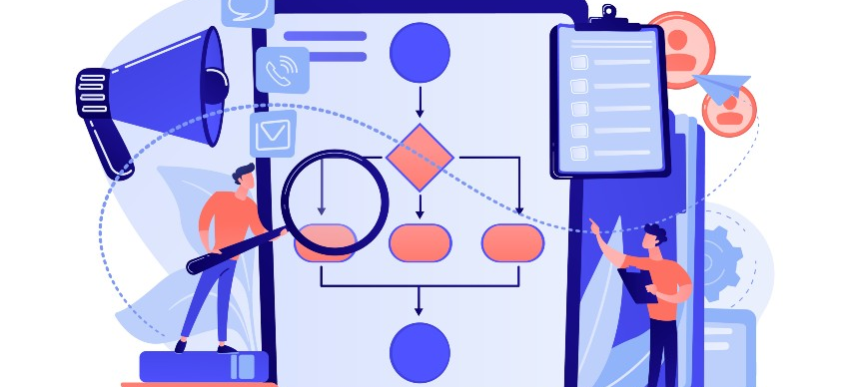
Diagrams

Slide 18
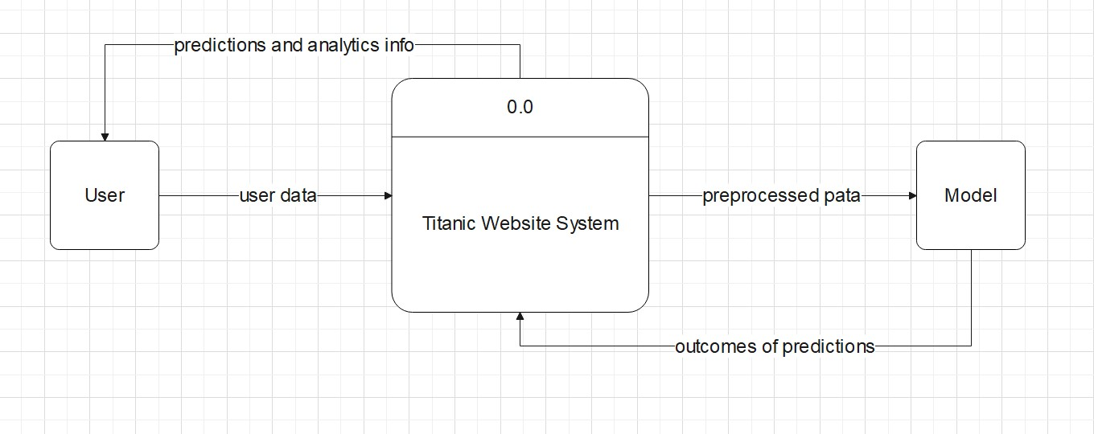
Context Diagram

Slide 19
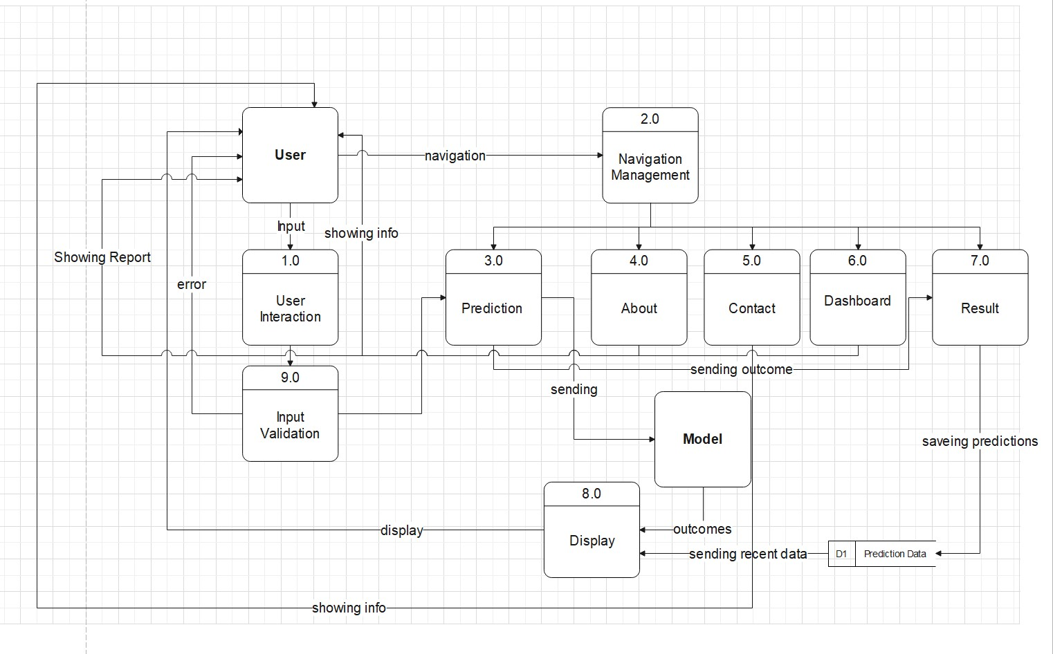
DFD

Slide 20
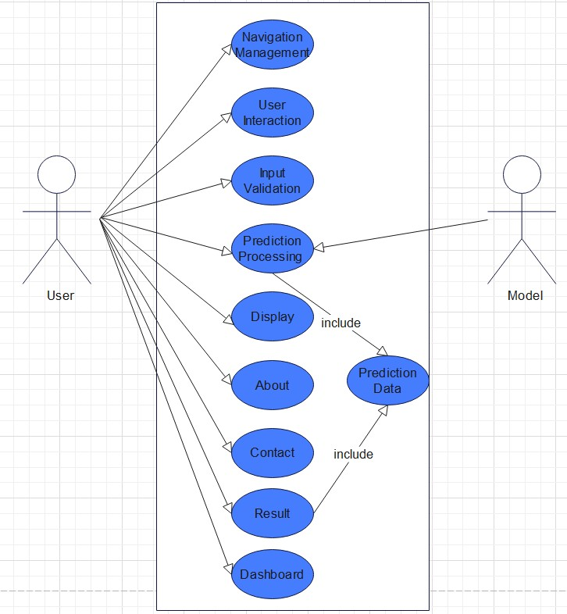
Use Case Diagram

Slide 21
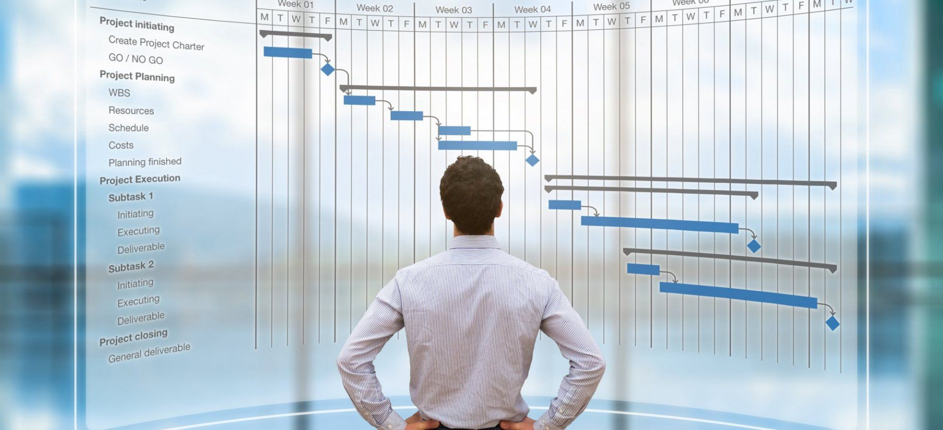
Project Management

Slide 22
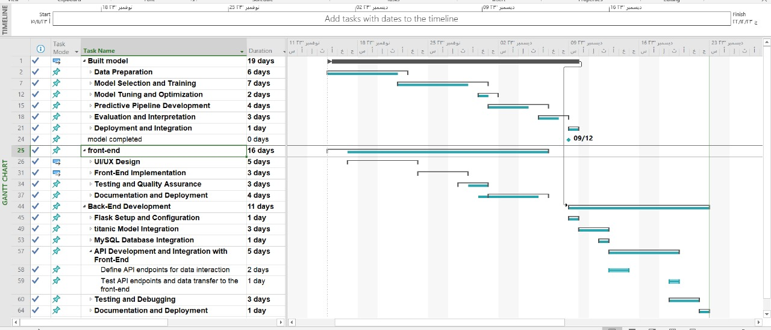

Slide 23
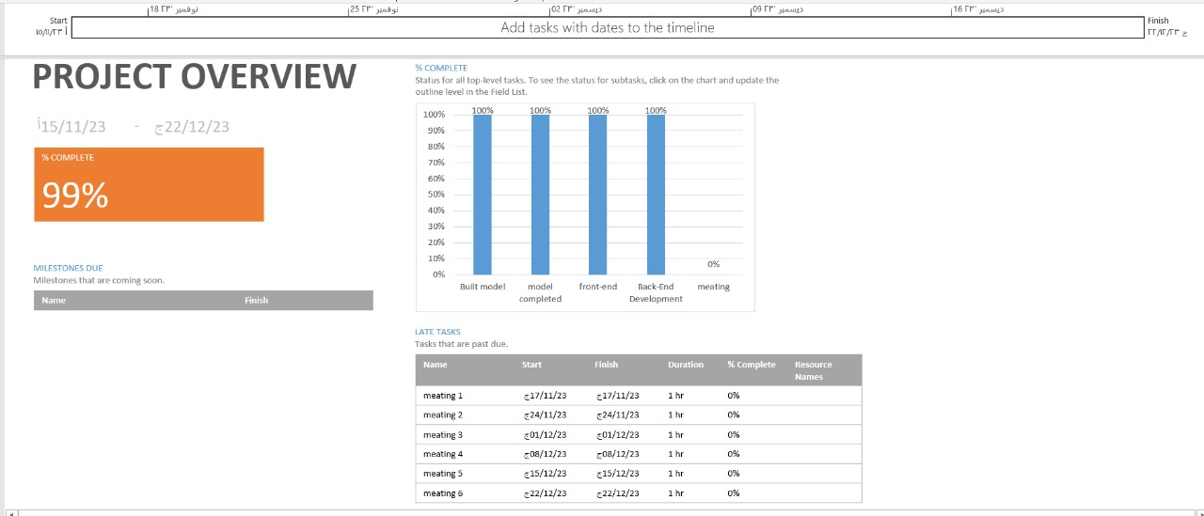

Slide 24
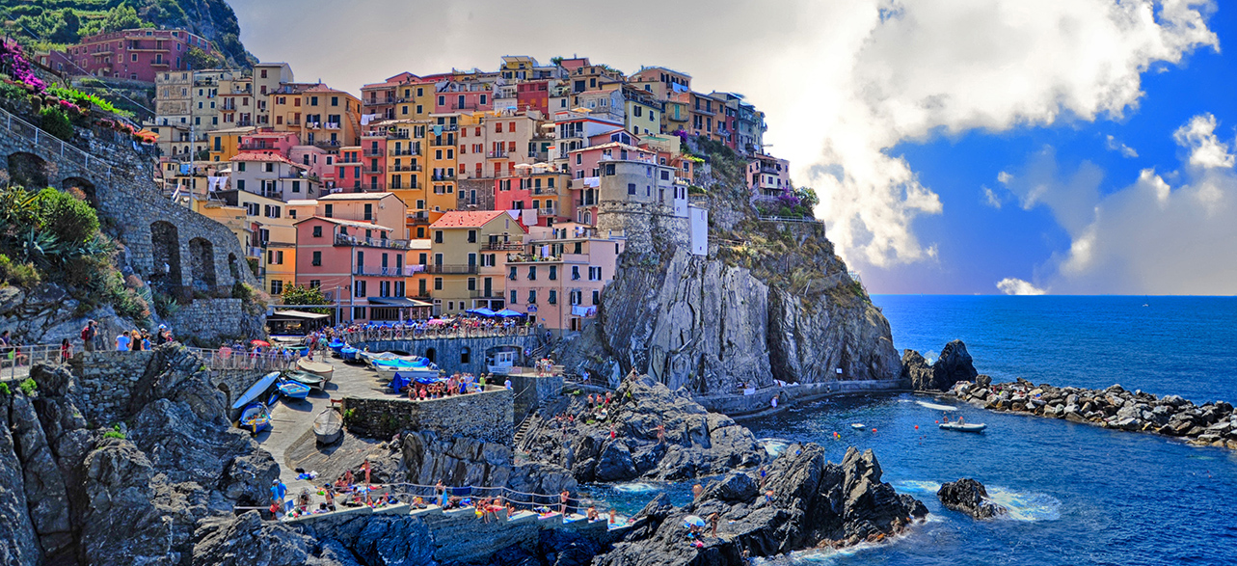
THANK TOU

